Slide 1

Module_4
Complexity Theory & Parallel Algorithms
Computational Complexity:
  Non Deterministic algorithms (Searching,sorting, knapsack,clique,sum of subsets),
  The classes: P, NP, NP Complete, NP Hard,
  Satisfiability problem
  Proofs for NP Complete Problems: Clique, Vertex Cover.
Parallel Algorithms:
  Basics of approximation
  Randomised algorithm
  Parallel Algorithms
Reference Books: Sahni
DAA_T.Y. B. Tech. (Computer Science and Engineering) Module_4

Slide 2
Reference Books: Sahni
Basic Concepts
Many of the problems that we know and study, can be clustered into two groups based on the computing times for solving using best algorithms.
Polynomial :
  Problems whose solution times are bounded by polynomials of small degree
  Searching: (log n),
  Sorting (heap) : n log n
Non-polynomial:
  Problems whose best known algorithms are non-polynomial.
  Travelling salesman problem O(n²2^{n})
  knap-sack O(2^{n/2})
DAA_T.Y. B. Tech. (Computer Science and Engineering) Module_4

Slide 3
Reference Books: Sahni
Deterministic Algorithms
Deterministic Algorithms :
  They have the property that the result of every operation is uniquely defined
  These algorithms agree the way the programs are executed on
DAA_T.Y. B. Tech. (Computer Science and Engineering) Module_4

Slide 4
Reference Books: Sahni
Non-Deterministic Algorithms
Non-Deterministic Algorithms :
  They have the property that the result of every operation is not uniquely defined but they are limited to specified sets of possibilities
  Three new functions are used to specify such algorithms.
    Choice(S) : arbitrarily chooses one of the elements of set S
    Failure(): signals unsuccessful termination
    Success(): signals successful termination
  Failure() and Success() cannot be used to effect a return
  Computing times of Choice, Failure, Success are taken to be O(1)
DAA_T.Y. B. Tech. (Computer Science and Engineering) Module_4

Slide 5
Reference Books: Sahni
Non-Deterministic Algorithms
Whenever there is a set of choices that leads to successful termination, one such set of choices is always made and algorithm terminates successfully.
A non-deterministic algorithm terminates unsuccessfully if and only if there exists no set of choices leading to a success signal.
Machine capable of executing non-deterministic algorithms is said to be nondeterministic machine.
Nondeterministic machines do not exist in practice.
They provide strong intuitive reasons to conclude that certain problems cannot be solved by fast deterministic algorithms
DAA_T.Y. B. Tech. (Computer Science and Engineering) Module_4

Slide 6
Reference Books: Sahni
Non Deterministic search
if a[j] =x then { write (j); Success();}
j = Choice(1,n)
write(0); Failure();
Non-deterministic complexity O(1) A is non ordered, every deterministic search algorithm is of complexity Ω(n)
DAA_T.Y. B. Tech. (Computer Science and Engineering) Module_4

Slide 7
Reference Books: Sahni
Non-deterministic sorting
Algorithm Nsort ( A, n)
// Sort n positive integers
{
for i= 1 to do B[i] = 0; // initialize B[]
for j= 1 to n do
{
j= Choice(1,n);
if( B[j] !=0) then Failure();
B[j] = A[i];
}
for i= 1 to n-1 do // verify order
if( B[i] > B[i+1] then Failure();
write( B[1..n]);
Success();
}
DAA_T.Y. B. Tech. (Computer Science and Engineering) Module_4

Slide 8
Reference Books: Sahni
Complexity Class P
Deterministic in nature
Solved by conventional computers in polynomial time
    O(1) Constant
    O(log n) Sub-linear
    O(n) Linear
    O(n log n) Nearly Linear
    O(n2) Quadratic
Polynomial upper and lower bounds
DAA_T.Y. B. Tech. (Computer Science and Engineering) Module_4

Slide 9
Reference Books: Sahni
Complexity Class NP
Non-deterministic part as well
choose(b): choose a bit in a non-deterministic way and assign to b
If someone tells us the solution to a problem, we can verify it in polynomial time
Two Properties: non-deterministic method to generate possible solutions, deterministic method to verify in polynomial time that the solution is correct.
DAA_T.Y. B. Tech. (Computer Science and Engineering) Module_4

Slide 10
Reference Books: Cormen
Polynomial-Time Reducibility
Language L is polynomial-time reducible to language M if there is a function computable in polynomial time that takes an input x of L and transforms it to an input f(x) of M, such that x is a member of L if and only if f(x) is a member of M.
Shorthand, LpolyM means L is polynomial-time reducible to M
DAA_T.Y. B. Tech. (Computer Science and Engineering) Module_4

Slide 11
Reference Books: Cormen
NP-Hard and NP-Complete
Language M is NP-hard if every other language L in NP is polynomial-time reducible to M
For every L that is a member of NP, LpolyM
If language M is NP-hard and also in the class of NP itself, then M is NP-complete
DAA_T.Y. B. Tech. (Computer Science and Engineering) Module_4

Slide 12
Reference Books: Cormen
NP-Hard and NP-Complete
Restriction: A known NP-complete problem M is actually just a special case of L
Local replacement: reduce a known NP-complete problem M to L by dividing instances of M and L into “basic units” then showing each unit of M can be converted to a unit of L
Component design: reduce a known NP-complete problem M to L by building components for an instance of L that enforce important structural functions for instances of M.
DAA_T.Y. B. Tech. (Computer Science and Engineering) Module_4

Slide 13
Reference Books: Cormen
Non-deterministic polynomial time
Deterministic Polynomial Time:
  The TM takes at most O(nc) steps to accept a string of length n
Non-deterministic Polynomial Time:
  The TM takes at most O(nc) steps on each computation path to accept a string of length n
DAA_T.Y. B. Tech. (Computer Science and Engineering) Module_4

Slide 14
Reference Books: Cormen
The Class P and the Class NP
P = Set of deterministic problems that can be solved in polynomial time.
NP = Set of non-deterministic problems that can be solved in polynomial time.
DAA_T.Y. B. Tech. (Computer Science and Engineering) Module_4

Slide 15
Reference Books: Cormen
P = NP?
No one knows if this is true
How can we make progress on this problem?
DAA_T.Y. B. Tech. (Computer Science and Engineering) Module_4

Slide 16
P = NP?
No one knows if this is true
How can we make progress on this problem?
DAA_T.Y. B. Tech. (Computer Science and Engineering) Module_4

Slide 17
Reference Books: Cormen
Progress
P = NP if every NP problem has a deterministic polynomial algorithm
We could find an algorithm for every NP problem
Seems… hard…
We could use polynomial time reductions to find the “hardest” problems and just work on those
DAA_T.Y. B. Tech. (Computer Science and Engineering) Module_4

Slide 18
Reference Books: Cormen
Reductions
Let us consider a decision problem A which has to be solve in polynomial time
We call input to that problem an instance of that problem
Now suppose there is different decision problem say B that we already know how to solve in polynomial time.
Finally suppose that we have a procedure that transforms any instance α of A into some instance β of B
DAA_T.Y. B. Tech. (Computer Science and Engineering) Module_4

Slide 19
Reference Books: Cormen
Reductions
The transformation takes polynomial time
The answers are the same. That is the answer for α is “yes” if and only if the answer for β is also “yes”
We call such a procedure a polynomial time reduction algorithm
DAA_T.Y. B. Tech. (Computer Science and Engineering) Module_4

Slide 20
Reference Books: Cormen
Reductions
yes
α
Polynomial-time reduction algorithm
β
Polynomial-time algorithm to decide B
no
Polynomial time algorithm to decide A
Given an instance α of problem A, use a polynomial –time reduction algorithm to transform it to an instance β of problem B
Run the polynomial-time decision algorithm for B on the instance β
Use the answer for β as the answer for α
DAA_T.Y. B. Tech. (Computer Science and Engineering) Module_4

Slide 21
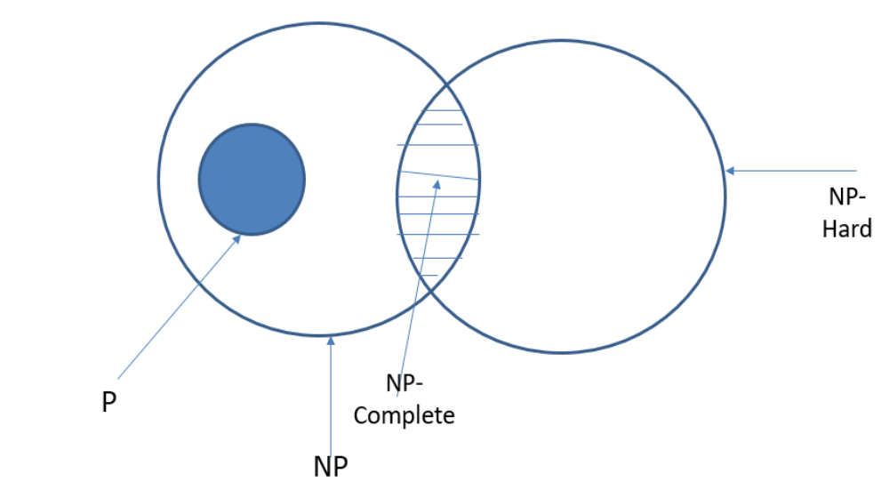
Relation-ship of P, NP,NP-hard & NP-Complete
Reference Books: Cormen
DAA_T.Y. B. Tech. (Computer Science and Engineering) Module_4

Slide 22
Reference Books: Cormen
Definition of NP-Complete
Q is an NP-Complete problem if:
1) Q is in NP
2) every other NP problem polynomial time reducible to Q
DAA_T.Y. B. Tech. (Computer Science and Engineering) Module_4

Slide 23
Reference Books: Cormen
Example
SAT is NP-Complete (already Proved using Cook-Levin Theorem )
DAA_T.Y. B. Tech. (Computer Science and Engineering) Module_4

Slide 24
Reference Books: Cormen
3-SAT
3-SAT = { f | f is in Conjunctive Normal Form, each clause has exactly 3 literals and f is satisfiable }
3-SAT is NP-Complete
(2-SAT is in P)
DAA_T.Y. B. Tech. (Computer Science and Engineering) Module_4

Slide 25
Reference Books: Cormen
NP-Complete
To prove a problem is NP-Complete show a polynomial time reduction from 3-SAT
Other NP-Complete Problems:
  CLIQUE
  VERTEX COVER
  HAMILTONIAN PATH (TSP)
  GRAPH COLORING
  PARTITION
  SUBSET-SUM
  MINESWEEPER (and many more)
DAA_T.Y. B. Tech. (Computer Science and Engineering) Module_4

Slide 26
Reference Books: Cormen
NP-Completeness Proof Method
To show that Q is NP-Complete:
1) Show that Q is in NP
2) Pick an instance, R, of your favorite NP- Complete problem (ex: Φ in 3-SAT)
3) Show a polynomial algorithm to transform R into an instance of Q
DAA_T.Y. B. Tech. (Computer Science and Engineering) Module_4

Slide 27
Reference Books: Cormen
The SAT Problem
One of the first problems to be proved NP-Complete was satisfiability (SAT):
Given a Boolean expression on n variables, can we assign values such that the expression is TRUE?
Cook’s Theorem: The satisfiability problem is NP-Complete
DAA_T.Y. B. Tech. (Computer Science and Engineering) Module_4

Slide 28
Reference Books: Cormen
3-CNF: Clique
What is a clique of a graph G?
A: a subset of vertices fully connected to each other, i.e. a complete subgraph of G
The clique problem: how large is the maximum-size clique in a graph?
Can we turn this into a decision problem?
A: Yes, we call this the k-clique problem
Is the k-clique problem within NP?
DAA_T.Y. B. Tech. (Computer Science and Engineering) Module_4

Slide 29
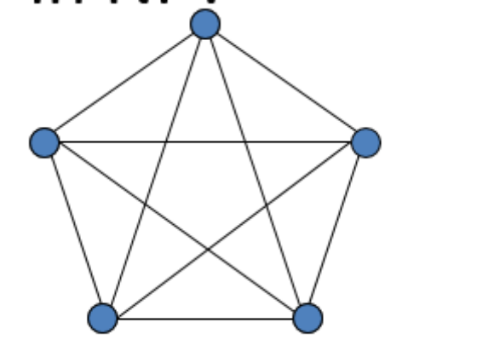
Reference Books: Cormen
Example: Clique
CLIQUE = { <G,k> | G is a graph with a clique of size k }
A clique is a subset of vertices that are all connected
Why is CLIQUE in NP?
DAA_T.Y. B. Tech. (Computer Science and Engineering) Module_4

Slide 30
Reference Books: Cormen
CLIQUE is NP-complete
Proof:
CLIUEQE NP: given G=(V,E) and a set V'V as a certificate for G. The verifying algorithm checks for each pair of u,vV', whether <u,v> E. time: O(|V'|2|E|).
CLIQUE is NP-hard:
show 3-CNF-SAT pCLIQUE.
The result is surprising, since from Boolean formula to graph.
DAA_T.Y. B. Tech. (Computer Science and Engineering) Module_4

Slide 31
Reference Books: Cormen
CLIQUE is NP-complete
Reduction from 3-CNF-SAT to CLIUQUE.
  Suppose φ=C1∧ C2∧… ∧Ck be a boolean formula in 3-CNF with k clauses.
  We construct a graph G=(V,E) as follows:
    For each clause Cr =(l1r∨ l2r∨ l3r), place a triple of v1r, v2r, v3r into V
    Put the edge between two vertices vir and vjs when:
      r≠s, that is vir and vjs are in different triples, and
      Their corresponding literals are consistent, i.e, lir is not negation of ljs .
  Then φ is satisfiable if and only if G has a clique of size k.
DAA_T.Y. B. Tech. (Computer Science and Engineering) Module_4

Slide 32
Reference Books: Cormen
CLIQUE is NP-complete
Prove the above reduction is correct:
  If φ is satisfiable, then there exists a satisfying assignment, which makes at least one literal in each clause to evaluate to 1. Pick one this kind of literal in each clause. Then consider the subgraph V' consisting of the corresponding vertex of each such literal. For each pair vir,vjs ∈V', where r≠s. Since lir,ljs are both evaluated to 1, so lir is not negation of ljs, thus there is an edge between vir and vjs. So V' is a clique of size k.
  If G has a clique V' of size k, then V' contains exact one vertex from each triple. Assign all the literals corresponding to the vertices in V' to 1, and other literals to 1 or 0, then each clause will be evaluated to 1. So φ is satisfiable.
It is easy to see the reduction is in poly time.
The reduction of an instance of one problem to a specific instance of the other problem
DAA_T.Y. B. Tech. (Computer Science and Engineering) Module_4

Slide 33
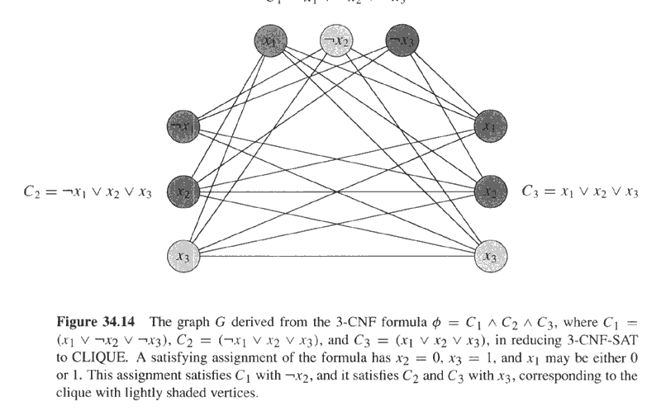
φ=(x₁∨¬x₂∨¬x₃)∧(¬x₁∨x₂∨x₃)∧(x₁∨x₂∨x₃) and its reduced graph G
Reference Books: Cormen
C₁=x₁∨¬x₂ ∨¬x₃

Slide 34
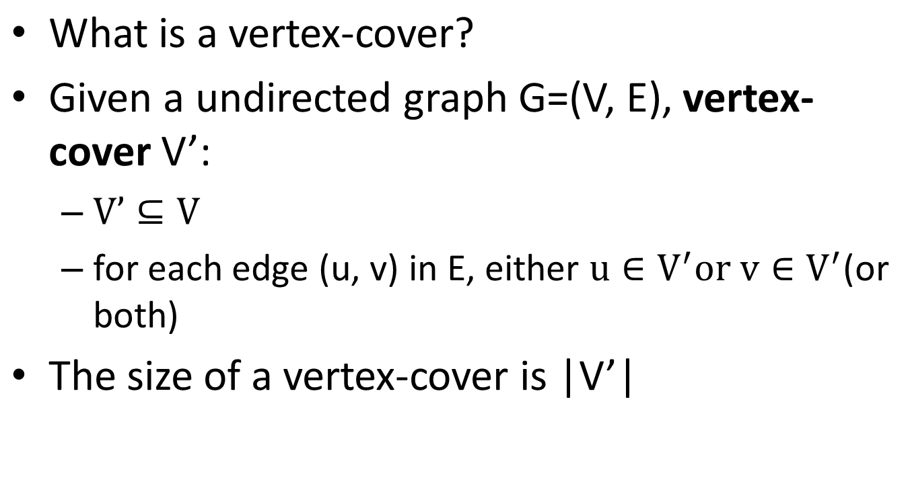
Reference Books: Cormen
Vertex Cover
DAA_T.Y. B. Tech. (Computer Science and Engineering) Module_4

Slide 35
Clique → Vertex Cover
Reference Books: Cormen
A vertex cover for a graph G is a set of vertices incident to every edge in G
The vertex cover problem: what is the minimum size vertex cover in G?
Restated as a decision problem: does a vertex cover of size k exist in G?
Vertex cover is NP-Complete

Slide 36
Clique → Vertex Cover
Reference Books: Cormen
First, show vertex cover in NP (How?)
The certificate we choose is the vertex cover V’ which is subset of V itself. Check
| V’| = k and then for each edge <u,v> Є E,
u Є V’ or v Є V’

Slide 37
Reference Books: Cormen
Next, reduce k-clique to vertex cover
  Reduction algorithm takes as input an instance <G,k> of the clique problem.
  It computes complement of G as GC in polynomial time
  The complement GC of a graph G contains exactly those edges not in G
  G has a clique of size k iff GC has a vertex cover of size |V| - k

Slide 38
u
v
u
v
z
w
z
w
y
x
y
x
Graph G_{C} produced by
reduction algorithm that has
vertex cover
V – V’ = {
Undirected graph with
Clique = V’= {u,v,x,y}

Slide 39
Clique → Vertex Cover
Claim: If G has a clique of size k, GC has a vertex cover of size |V| - k
  Let V’ be the k-clique
  Then V - V’ is a vertex cover in GC
    Let (u,v) be any edge in GC
    Then u and v cannot both be in V’ (Why?)
    Thus at least one of u or v is in V-V’ (why?), so
    edge (u, v) is covered by V-V’
    Since true for any edge in GC, V-V’ is a vertex cover

Slide 40
Clique → Vertex Cover
Claim: If GC has a vertex cover V’ ⊆ V, with |V’| = |V| - k, then G has a clique of size k
  For all u,v ∈ V, if (u,v) ∈ GC then u ∈ V’ or
  v ∈ V’ or both (Why?)
  Contrapositive: if u ∉ V’ and v ∉ V’, then
  (u,v) ∈ E
  In other words, all vertices in V-V’ are connected by an edge, thus V-V’ is a clique
  Since |V| - |V’| = k, the size of the clique is k

Slide 41
Approximation Algorithms

Slide 42
Introduction
Approximation algorithms are used to get a solution close to the (optimal) solution of an optimization problem in polynomial time
For example, Traveling Salesman Problem (TSP) is an optimization problem (the route taken has to have minimum cost).
Since TSP is NP-Complete, approximation algorithms allow for getting a solution close to the solution of an NP problem in polynomial time.

Slide 43
Definition
An algorithm is an α-approximation algorithm for an optimization problem Π if
The algorithm runs in polynomial time
The algorithm always produces a solution that is within a factor of α of the optimal solution
Minimization – α < 1
Maximization – α > 1

Slide 44
Set Cover (SC)
A set cover of a set T is any collection of subsets of T whose union is T.
The set cover problem: given a weight for each subset, find the set cover which minimizes the total weight

Slide 45
Example of Vertex Cover
Possible Solutions are:
{ 1, 3, 4 }
{ 1, 7, 5 }
If the weights are the vertex numbers, then the optimal solution is: {1, 3, 4}
The Graph
1
2
7
3
6
4
5

Slide 46
Vertex Cover as Set Cover
Vertex Cover is a special case of Set Cover
To convert a problem from vertex cover to set cover:
Make T = the set of edges E
Make the subsets correspond to each vertex, with each subset containing the set of edges that touch the corresponding vertex

Slide 47
Randomized Algorithm
The output or the running time are functions of the input and random bits chosen .
Random bits
Input
Output
Algorithm

Slide 48

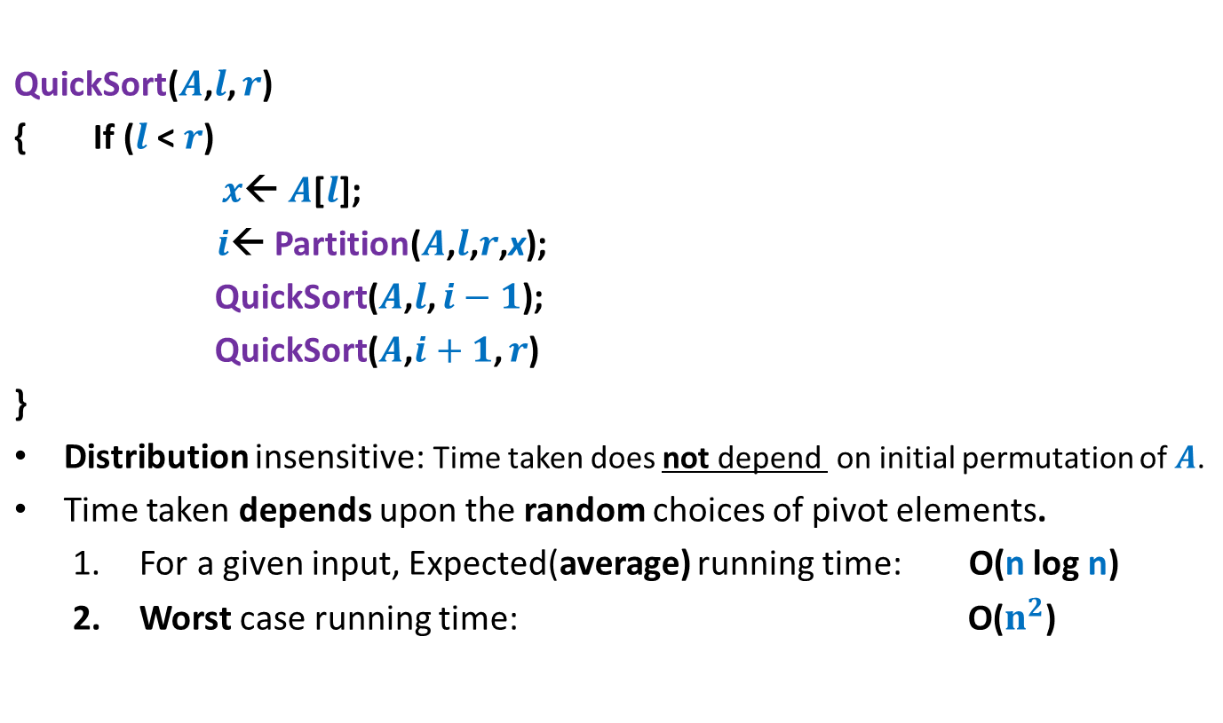

Slide 49
Types of Randomized Algorithms
Randomized Las Vegas Algorithms:
  Output is always correct
  Running time is a random variable
  Example: Randomized Quick Sort
Randomized Monte Carlo Algorithms:
  Output may be incorrect with some probability
  Running time is deterministic.
  Example: Randomized algorithm for approximate median

Slide 50
Motivation for randomized Algorithms
“Randomized algorithm for a problem is usually simpler and more efficient than its deterministic counterpart.”

Slide 51
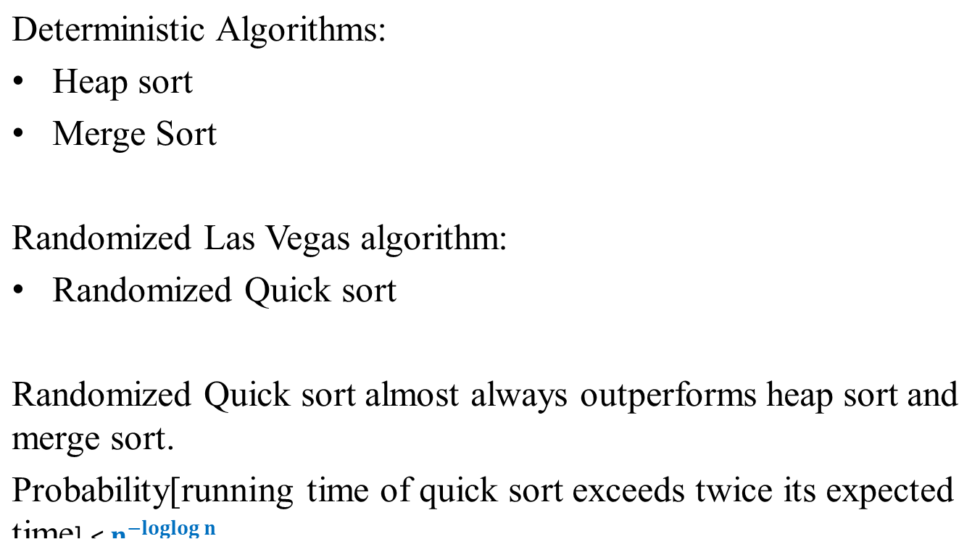

Example 1: Sorting

Slide 52
Parallel Algorithm
Parallel: perform more than one operation at a time.
PRAM model: Parallel Random Access Model.
Multiple processors connected to a shared memory.
Each processor access any location in unit time.
All processors can access memory in parallel.
All processors can perform operations in parallel.
p₀
Shared
memory
p₁
p_{n-1}

Slide 53
Concurrent vs. Exclusive Access
Four models
  EREW: exclusive read and exclusive write
  CREW: concurrent read and exclusive write
  ERCW: exclusive read and concurrent write
  CRCW: concurrent read and concurrent write
Handling write conflicts
  Common-write model: only if they write the same value.
  Arbitrary-write model: an arbitrary one succeeds.
  Priority-write model: the one with smallest index succeeds.
EREW and CRCW are most popular.
DAA_T.Y. B. Tech. (Computer Sciece and Engineering) Module_4

Slide 54
Synchronization and Control
Synchronization:
  A most important and complicated issue
  Suppose all processors are inherently tightly synchronized:
    All processors execute the same statements at the same time
    No race among processors, i.e, same pace.
Termination control of a parallel loop:
  Depend on the state of all processors
  Can be tested in O(1) time.
DAA_T.Y. B. Tech. (Computer Science and Engineering) Module_4

Slide 55
Parallel Computation
To describe parallel algorithm , use statements of general form as :
  for x Є S in parallel do statement(x);
  Eg.
  For 1<=i <=10 in parallel do statement(i);

Slide 56
Parallel Computation
Parallel algorithms are designed to improve the computation speed of a computer. For analyzing a Parallel Algorithm, we normally consider the following parameters −
Time complexity (Execution Time),
Total number of processors used, and
Total cost.

Slide 57
Parallel Computation
Total cost of a parallel algorithm is the product of time complexity and the number of processors used in that particular algorithm.
Total Cost = Time complexity × Number of processors used
Therefore, the efficiency of a parallel algorithm is −
Efficiency = Worst case execution time of sequential algorithm / Worst case execution time of the parallel algorithm

Slide 58
Basic Techniques and algorithms
Complete Binary Tree
No of leaf nodes=08
No of processors=2*n-1

Slide 59
Example
Sum of n numbers is calculated using binary tree
Algorithm:
1.Each processor at leaf sends the number to its parent to start with.
2.On receipt of two numbers, an internal processor finds sum and send result to father
3.The process stops when root processor calculates sum.

Slide 60
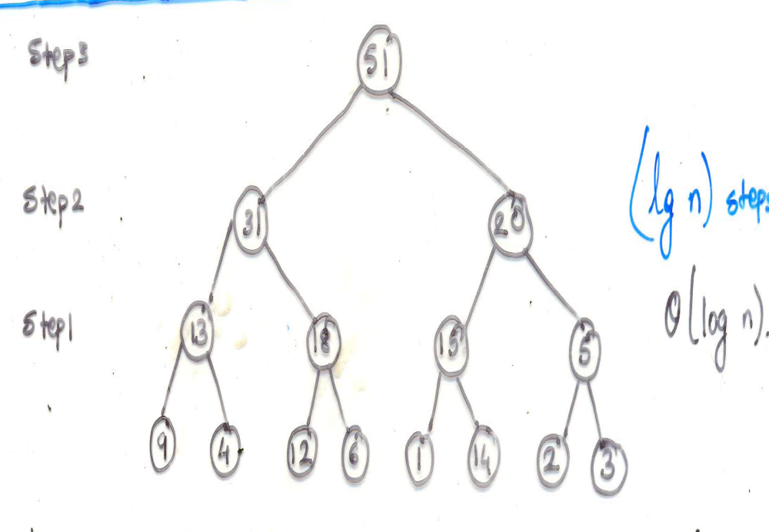
Example
5
2
3
1
9
-2
4
6
Prof. Anita Thengade

Slide 61
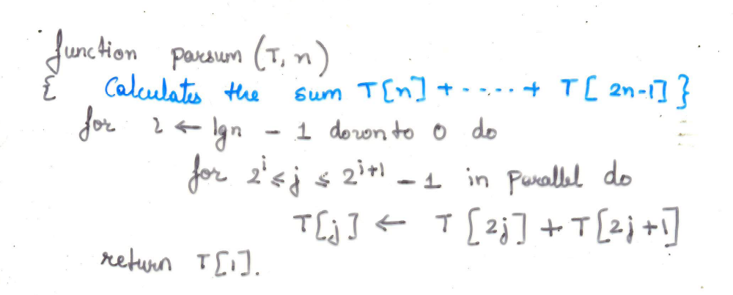
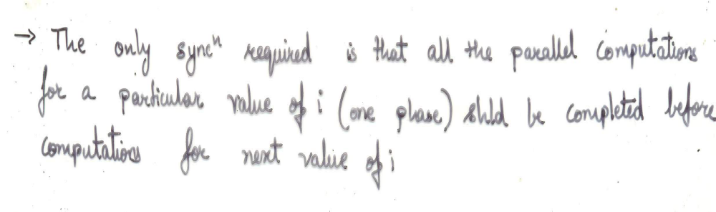
Algorithm
Prof. Anita Thengade

